Slide 1

Advanced Database Systems
Professor Joann J Ordille
jo531@scarletmail.rutgers.edu
Fall 2022
Photo by Jack Moreh from Freerange Stock

Slide 2

Overview
Introductions
Slido
Communication
Course Philosophy
Course Materials
Syllabus and Course Information
Cloud
AWS Academy Module Preview
Group Formation
Upcoming Assignments
Jobs
Photo by Jack Moreh from Freerange Stock. Remaiinder © 2022 Joann J Ordille, joann.ordille@rutgers.edu

Slide 3
Introductions
About Professor Ordille
Around the Room
Name
Degree you’re pursuing
Introduce Yourself on Flipgrid Assignment
Click through to Flipgrid from the assignment
Qualtrics Survey

Slide 4
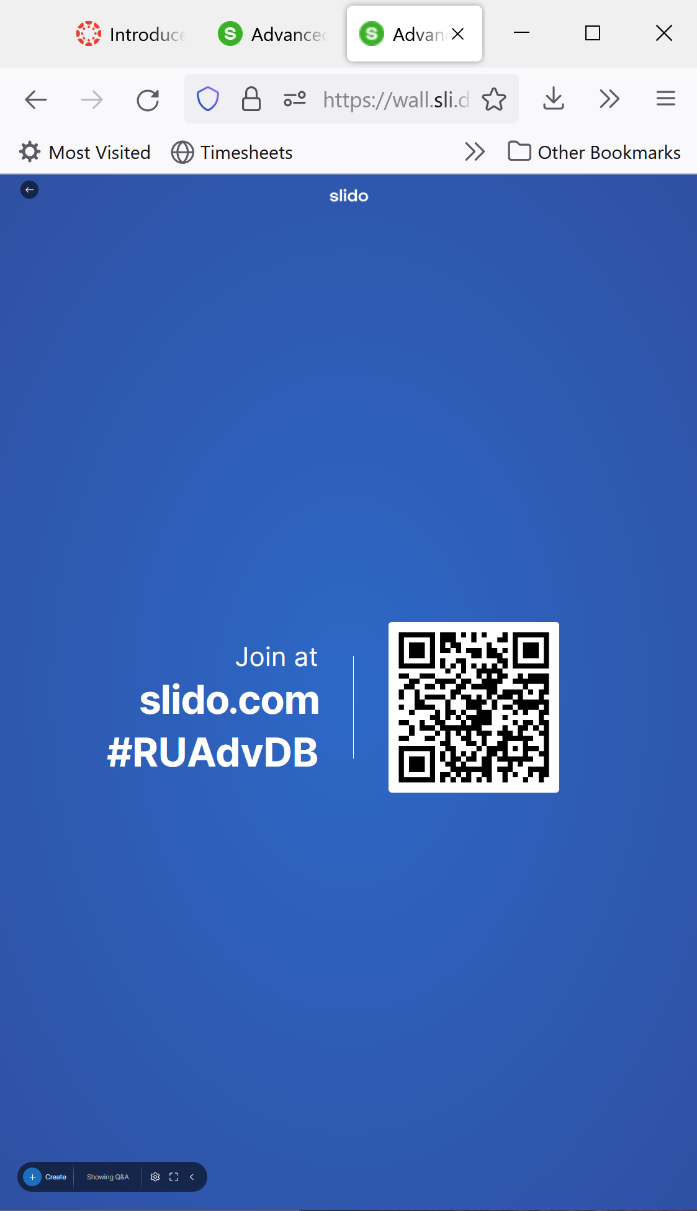
Slido
You can join the class slido by going to slido.com and entering the class code listed on the Canvas home page
You can also scan the QR-code at the beginning of class
You can raise questions on slido
We will do some polls there as well

Slide 5
GroupMe and Email
Please ask me questions that will help your classmates on GroupMe, so everyone will benefit from the answer.
Please don’t send me Canvas inbox messages. Send Scarlet Mail or a GroupMe DM instead. Both of these provide a conversation structure, so I can associate answers with previous questions. They also alert my cell phone.

Slide 6


Imagine You are a Professor of 300 students

Slide 7
Office Hours
Office hours are in-person in my office in Levin 231 or Newark, and in the Office Hours Zoom Link.
T,Th: 2:30 – 3:30 pm [Livingston Campus]
T: 5:45 – 6:15 pm [Livingston Campus]
W: 1:45 – 2:45 pm [Newark Campus]

Slide 8
Course Philosophy
A combination of experience and conceptual understanding
Exercises and Labs to gain first-hand knowledge of cloud services and noSQL databases
Reading, videos and discussion of research papers, trade press, and educational materials to gain conceptual understanding AND knowledge of the movement/trends in the field
The project is your opportunity to take a deep-dive into the area that most interests you.
Research Survey Paper
Your Own Research
Build a Prototype to Validate/Extend Someone’s Published Research
Build an Application (Masters Students Only)

Slide 9
Course Materials
Books
Research Papers
Supplementary Examples and Educational Materials to Fill Gaps
AWS Cloud Foundations Course
Exercises on Laptop, AWS Learner Lab, AWS Account
Be sure to invitations from the AWS Academy – one for the Cloud Foundations course and one for the Learner Lab.

Slide 10

Syllabus
Class Attendance | 3%
Team Participation | 5%
Team Class Presentation | 5%
Homework | 5%
Midterm | 22%
Individual Project | 30%
Final Exam | 30%
Syllabus Link

Slide 11
Final Grade Scale
The course is designed, so that you can achieve points in various categories.
The total points achieved determine your final grade.
There is no extra credit at the end to adjust your grade.
I rarely have the need to curve, and then only in response to statistical analysis of the whole class.
A: 90-100 | B+: 85-89 | C+: 75-79 | F: 0-69
 | B: 80-84 | C: 70-74

Slide 12

Cloud Computing Use Cases/Drivers
Do you use cloud computing? If so, how and why?
Would a startup company selling on the Internet use cloud computing?
How about a Fortune 500 company with little Internet presence?
© 2022 Joann J Ordille, joann.ordille@rutgers.edu

Slide 13

Types of Services (Service Models) Offered by the Cloud Providers
Infrastructure as a Service (IaaS)
Platform as a Service (PaaS)
Software as a Service (SaaS)
© 2022 Joann J Ordille, joann.ordille@rutgers.edu

Slide 14
Cons of Cloud Computing
© 2022 Joann J Ordille, joann.ordille@rutgers.edu

Slide 15
Benefits of Cloud Computing
© 2022 Joann J Ordille, joann.ordille@rutgers.edu

Slide 16
Cloud Native
"A cloud native app is architected specifically to run in the elastic and distributed nature required by modern cloud computing platforms," Mike Kavis, a managing director with consulting firm Deloitte, told Infoworld last June.
As quoted in Laberis, B. (2019). The disruptive force of cloud native. Natunix. https://www.nutanix.com/theforecastbynutanix/technology/the-disruptive-force-of-cloud-native
Technology Changes
Microservices
Containers
Serverless Computing
Process Changes
DevOps
Continuous Deployment
© 2022 Joann J Ordille, joann.ordille@rutgers.edu

Slide 17
Enabler
A View of Cloud Computing
“We argue that the construction and operation of extremely large-scale, commodity-computer data centers at low-cost locations was the key necessary enabler of cloud computing, for they uncovered the factors of 5 to 7 decrease in cost of electricity, network bandwidth, operations, software and hardware available at these very large economies of scale.”
Quoted from Armbrust, M., Fox, A., Griffith, R., Joseph, A. D., Katz, R., Konwinski, A., ... & Zaharia, M. (2010). A view of cloud computing. Communications of the ACM, 53(4), 50-58. (9 pages) https://github.com/rxin/db-readings/blob/master/papers/cloud-computing.pdf

Slide 18
Definition of Cloud Computing (from Table 1)
A View of Cloud Computing
Appearance of infinite computing resources on demand (computing as a utility)
Elimination of an up-front commitment by Cloud users
Ability to pay for use of computing resources on a short-term basis
Economies of scale due to very large data centers
Higher utilization by multiplexing workloads from different organizations
Simplify operation and increase utilization via resource virtualization

Slide 19
Compelling Use Cases
A View of Cloud Computing
Demand for service varies over time
Peak workload often exceeds average workload by a factor of 2 to 10
Service demand is unknown in advance
Batch analytics on large datasets
Transfer risk of over-provisioning (under-utilization) and of under-provisioning (saturation)

Slide 20

Team Formation
Form Teams of Four
Pick a paper to present
© 2022 Joann J Ordille, joann.ordille@rutgers.edu

Slide 21

AWS Academy Cloud Foundation Modules
You may need to pause the videos and google some terms
Post questions on group me if something is unclear, and I or a classmate will fill the background
© 2022 Joann J Ordille, joann.ordille@rutgers.edu

Slide 22
Things Due Soon
Introduce Yourself on Flipgrid
01
Reading Assignment on Canvas
02
AWS Cloud Foundations, Introduction and Modules 1-4 including one lab
03
Install the tools
04
Unless noted, pictures, illustrations and graphics were created by Joann J Ordille and/or fully or partially generated by PowerPoint.

Slide 23

Jobs
Recruiting season for internships and full-time jobs is in the Fall.
There are special development programs for new graduates, as well as interns.
Companies seek to create a pipeline to get the best talent. That pipeline begins with internships and other programs while you are a student.
Companies want to convince the best candidates to take a job early in the recruiting season to reduce competition from other companies.
Photo by StuartMiles from Freerange Stock, used with permission. Remainder
© 2022 Joann J Ordille, joann.ordille@rutgers.edu.

Slide 24

Job Search Tips
Come up with a list companies you want to target, as well as looking at job advertisements.
Search for the company and the word student, or internship, or new graduate. Try them all.
Example web sites:
Google Internships and Full-Time College Grad Opportunities: https://careers.google.com/students/
Amazon Internships: https://amazon.jobs/en/teams/internships-for-students
J. P. Morgan Chase Internships and Full-Time College Grad Opportunities: https://careers.jpmorgan.com/global/en/students/programs
Goldman Sachs: https://www.goldmansachs.com/careers/students/programs/
Pfizer Early Career Opportunities (Summer and Full-Time): https://www.pfizer.com/en/about/careers/early-careers
Ford Internships and Early Careers: https://corporate.ford.com/careers/programs/students-and-recent-graduates.html
Photo by Jack Moreh from Freerange Stock Remainder © 2022 Joann J Ordille, joann.ordille@rutgers.edu.

Slide 25
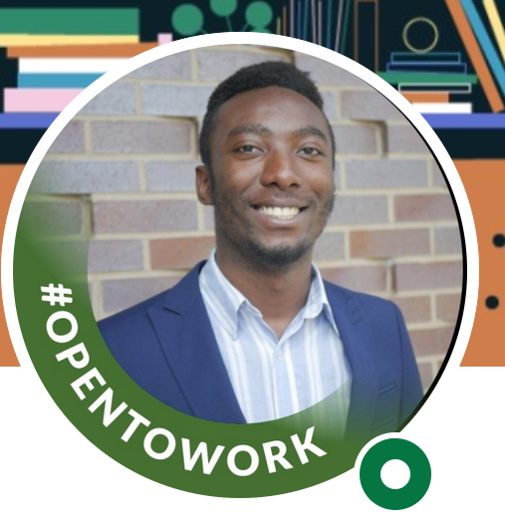
Other Resources
RBS Office of Career Management: https://myrbs.business.rutgers.edu/career-management/undergrad-nb
Association for Computing Machinery Jobs: https://jobs.acm.org/
I’ve seen business internships posted.
Grace Hopper Celebration of Women in Computing Resume Database: https://ghc.anitab.org/attend/resume-database
Lots of companies look at this one.
LinkedIn. Be sure to mark your profile as looking for a job.
Does your favorite social media platform have job postings?
Google, Indeed.com.
Consider a tool that matches your resume against the job ad. There are several. I’ve used: https://www.jobscan.co/

